Slide 1

Lessons in Leading High Performance Teams
Moving From Individual Contributor to Team Leader
Notes:
Note to facilitator:
This webcast requires the assistance of a Virtual Producer.
Welcome participants to the webcast.
Explain that this webcast focuses on the difference between an individual contributor and a Team Leader and the ways teams can maximize all of the human resources on the team by empowering individuals and creating interdependence and commitment around their common goal.

Slide 2
Team Leader Webcast Series Goal
Even under the best of circumstances leading a team is challenging. This webcast series is designed for Team Leaders who must manage diverse and often cross-functional teams.
THE GOAL: TO HELP YOU BRING YOUR TEAMS TOGETHER IN ORDER TO ACHIEVE THE DESIRED BUSINESS RESULTS AND REACH YOUR COMMON GOAL
Notes:
Say:
Even under the best of circumstances leading a team can be challenging. You have brought together a diverse group of people with varying backgrounds, experiences, and expertise.
The goal of this webcast series is to help you, as the Team Leader, bring your team together to achieve the desired business results and reach your common goal. You may choose to attend all of the webcasts in the series or just select those that are the most relevant to your position.

Slide 3
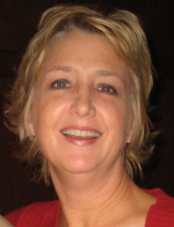
Meet Your Presenter
Kelly Woodward
Managing Director, Woodward and Associates
E-mail: kelly_woodward@msn.com
Over 20 years of experience in education, management, sales and employee development in the life sciences industry
Merck Alumni, USHH Sales Training and Professional Development
Notes:
Note to facilitator:
The Virtual Producer will open the call and provide directions on how to use the various tools within the platform. After this logistics overview, the Virtual Producer will introduce the LL&D point for the webcast who will offer introductory comments then handoff to the webcast leader (presenter). The webcast leader should have the camera on for the introduction.
Introduce yourself and include:
Basic information such as name, position and contact information
Relevant biographical notes
Keep the introduction brief.
Explain that this webcast will be very interactive and use the X to indicate you have stepped away (Do Not Disturb sign)

Slide 4

The Benefits of Participating Today
You will be able to:
Make the essential transition from individual contributor to Team Leader
Create interdependence and commitment within the team by fostering an environment where a shared purpose, social support and a voice exist
Notes:
Say:
By participating in today's webcast you will be able to:
Make the essential transition from individual contributor to Team Leader
Create interdependence and commitment within the team by fostering an environment where a shared purpose, social support and a voice exist
Ask:
Who is responsible for the success of the team?
Explain that they can comment by raising their virtual hand on the tool bar.
Call on each person who raised his or her hand and un-mute the audio if necessary.
Response: Every member of the team.
Say:
Although ultimately you will be held accountable for the results of the team, every member is 100% responsible for the team’s success. Therefore, it is in your best interest to foster an environment where every member of the team takes personal responsibility for getting things done. That they see themselves as a group of people who collectively represent the organization’s interests and will each take on a leadership role to ensure a successful outcome.

Slide 5
Teams: The Primary Organizational Structure
TEAMS
Handle Complex Projects
Achieve Predictable Outcomes
Leverage Diverse Talents Experience
Meet Challenging Business Objectives
Notes:
Say:
Teams are no longer an option for achieving work but the primary organizational structure for handling complex and challenging projects. That is why your role as a Team Leader is so important to Merck and MSD.
Review the slide.
Say:
Your teams have been formed to handle complex business projects. They are designed to meet challenging business objectives, not a mechanism for only building relationships.
Teaming requires the kind of leadership that can create collaboration, successful team processes and effective execution. It requires alignment around goals and clear roles and responsibilities and follows a specific plan of development to achieve high performance. As a result of participating in this series of webcasts you will be better prepared to support your team’s journey to high performance.
Today we begin with your journey to becoming an effective Team Leader. We will be focusing on moving from individual contributor to Team Leader.

Slide 6

What If I…
What If I…
Notes:
Say:
Let’s watch a brief video that highlights some of the characteristics of effective Team Leaders.
Show the inspirational video that inspires Team Leaders and members to unite and work towards a common goal.
Click the link (What IF I…) to begin the video.

Slide 7
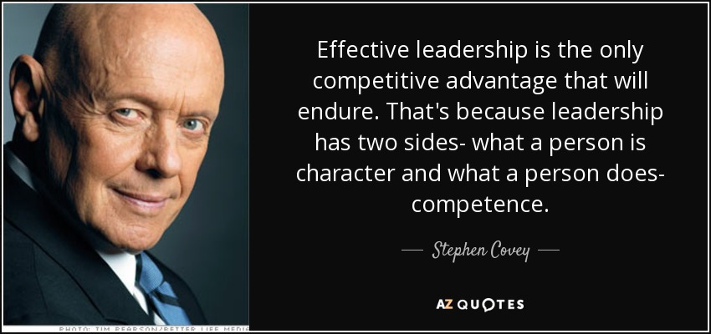
What Does Effective Leadership Require?
Notes:
Say:
As you saw in the video being on a team requires many different characteristics and talents and a Team Leader carries the additional responsibility to be a role model as reinforced by this quote from Stephen Covey.
Read the Steven Covey quote on the slide.

Slide 8

Creating a High Performing Team: Two Sides to the Coin
Trust and Collaboration Build
A Supportive Team Culture
Processes Help
Meet Team Objectives
Character
Competence
Tasks
Inspires
Aligns People to the Vision
Creates a Culture Where Healthy Conflict Exists
Encourages Open Dialogue and Exchange
Facilitates Individual Development
Purpose, Strategy
& Goal Clarification
What
How
Ground Rules
Role Definition
Project Planning & Tracking
Decision Making
Conflict Resolution
Meeting Management
Stakeholder Plan & Communication Plan
Notes:
Say:
Being an effective Team Leader is no small task. As Stephen Covey said in his quote there are two sides of the coin required to become an effective leader: Character and Competence.
Click to build the slide and explain that competence is what we do and character is how we do it. If you are familiar with Stephen Covey’s The Speed of Trust, you will remember that Character and Competence make up trust. Trust is contagious.
Explain that each webcast will focus on one or both of these aspects of leadership. For this webcast we will be focusing on character.

Slide 9
Work Group vs. Team
Share skills and knowledge
Team Goal
Same Manager
Individual objectives
Individual goals
Individual results
Evaluated on individual outcomes
Notes:
Explain the difference between a team and work group.
Say:
The words 'group' and 'team' are, for the most part, interchangeable - at least most people use them that way. But there are distinct differences between groups and teams. For example, we have a football team, not a football group - or we have a special interest group, not a special interest team. While the differences are subtle, they are indeed different, and we need to understand what those differences are.
The main difference is that a team's strength or focus depends on the commonality of their purpose and how the individuals are connected to one another. For a team to successfully meet their goal, they must leverage the talents and skills of each team member which creates interdependencies.
A work group, on the other hand, is defined as individuals who have the same manager, who have individual goals and objectives and are then evaluated by their manager on their effectiveness on reaching their individual goals. Some of you may be part of a work group but it may be called a team. If a business goal can be met through the sum of each individuals accomplishments, then a team is not needed.
What we’ve seen at Merck and MSD – is quite often a hybrid – part team and part work group.

Slide 10

What Do Your Teams Look Like?
How many of you are or will be leading team members that don’t directly report to you?
Notes:
Note to facilitator:
The next four slides are polling questions. Polling questions throughout this slide deck are always indicated by the red pencil and check boxes. Work with the Virtual Producer to set these up in advance of the webcast.
This series of questions will help you discover how many participants on the call will be leading a team vs. work group. Positive responses to the questions indicate that they are likely leading cross-functional teams.
A cross-functional team is a group of people with different functional expertise working toward a common goal. Typically, it includes employees from many levels of an organization and may even include members from outside the organization (suppliers, consultants, vendors).
Even if you have a number of participants who are managers of homogeneous work groups they can still glean valuable information from this webcast.
Say:
Let’s find out a little more about the teams you will be or are currently leading.
Ask the polling question.

Slide 11
What Do Your Teams Look Like?
How many of you are or will be leading virtual team members?
Notes:
Ask the polling question.

Slide 12
What Do Your Teams Look Like?
How many of you have or will have individuals on the team of varying levels/bands?
Notes:
Ask the polling question.

Slide 13
What Do Your Teams Look Like?
How many of you are or will be leading team members from outside the organization such as vendor partners or consultants?
Notes:
Ask the polling question.
Say:
As you can see from the responses to the questions, leading these teams will be no easy task. Let’s take some time to think about the challenges you may face.

Slide 14
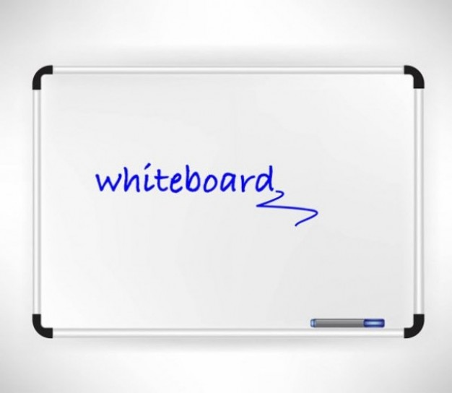
Whiteboard Activity
What are some of the inherent challenges when leading a team?
Notes:
Note to facilitator:
This discussion will be carried out using the whiteboard function. Work with the Virtual Producer to set this up in advance of the webcast.
Ask participants to respond to the question on the slide by recording their responses on the whiteboard.
Read some of the responses aloud.
Point out common themes in the responses.

Slide 15

What Got You Here Won’t Get You There
“In this book, Marshall Goldsmith begins by examining the trouble with success, explaining how previous accomplishments often prevent leaders from gaining more success. He analyzes why high achievers are so resistant to change due to their delusion of success, pointing out that they can’t see that what got them here won’t get them there.”
Notes:
Explain that the way the participants may have approached things as an individual contributor may not serve them well or help them to overcome some of the inherent challenges when leading teams.
Explain that Marshall Goldsmith, with Mark Reiter, wrote a book called What Got You Here Won’t Get You There.
Read the synopsis on the slide.
Say:
Let’s start thinking about some of the behaviors that led to your success as individual contributors but may not serve you as a Team Leader.

Slide 16
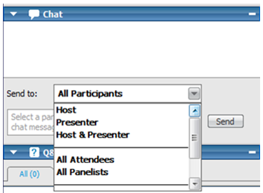
Large Group Chat
What behaviors helped you excel as an individual contributor but might get in the way of being an effective Team Leader.
Notes:
Note to facilitator:
This discussion will be carried out using the large group chat function.
Ask participants to respond to the question on the slide by selecting ‘All Participants’ in the ‘Send to’ dropdown box and typing in their responses.
Read some of the responses aloud.
Point out common themes in the responses.

Slide 17
As You Move From Individual Contributor to Team Leader
Individual Contributor | Team Leader
Guided by others | People follow your example
In control | Shared control
Secure and confident | Reinforces others’ strengths
Protects status quo | Builds relationships and trust
Technical orientation | Strategic orientation
Determine what to do and execute the plan | Develops people
Problem solving capabilities | Stimulates innovative ideas
Notes:
Summarize the conversation by explaining that in addition to the things that made you successful as in individual contributor, as a Team Leader you will also need to adopt or demonstrate additional behaviors such as:
Shared control
Reinforcing others’ strengths
Review the slide.
Ask the group if they have others to add. Explain that they can comment by raising their virtual hand on the tool bar.
Call on each person who raised his or her hand and un-mute the audio if necessary.

Slide 18

Things Great Leaders Say
What do you need from me to make this a success?
I value your contribution.
How could we do this better?
You’ve done a great job!
Thank you.
Notes:
This slide builds
Say:
In addition to the new behaviors you may have to acquire, great Team Leaders change the language that they use.
Review the slide.
Say:
This type of language helps you acknowledge the efforts and contributions of the team.

Slide 19

Whiteboard Activity
What do you need to do to move from individual contributor to Team Leader?
What do I need to do more of?
What do I need to do less of?
Notes:
Note to facilitator:
This discussion will be carried out using the whiteboard function. Work with the Virtual Producer to set this up in advance of the webcast.
Ask participants to respond to the question on the slide by recording their responses on the whiteboard. Point out that there are two columns on the whiteboard. In the left hand column participants should record what behaviors they need to demonstrate more of and in right hand column the behaviors they should not demonstrate as often.
Ask the group if they would like to comment on the list.
Explain that they can comment by raising their virtual hand on the tool bar.
Call on each person who raised his or her hand and un-mute the audio if necessary.

Slide 20
Effective Team Leader Skills
In general effective Team Leaders have the ability to:
Lead by example
Communicate critical information clearly, succinctly, and in a timely way
Respond quickly and decisively to changing situations as well as to others' ideas and needs
Motivate others to work effectively both as a team and individually
Connect with the team across roles and functions
Collaborate will with others and display good will and humor
Mentor others
Notes:
Summarize the conversation by displaying this slide that describes effective Team Leader skills.
Review the slide.

Slide 21
Effective Team Leader Skills
In general effective Team Leaders have the ability to:
Lead by example
Communicate critical information clearly, succinctly, and in a timely way
Respond quickly and decisively to changing situations as well as to others' ideas and needs
Motivate others to work effectively both as a team and individually
Connect with the team across roles and functions
Collaborate will with others and display good will and humor
Mentor others
Polling Question: Which side of the coin do most of these skills fall under:
Competence
Character
Notes:
Note to facilitator:
This slide is a polling question. Polling questions throughout this slide deck are always indicated by the red pencil and check boxes. Work with the Virtual Producer to set this up in advance of the webcast.
Ask the polling question.
Point out that many of the skills needed to be an effective Team Leader fall under ‘character’ where in the past, as an individual contributor, many likely fell under ‘competence’.
Say:
As you lead your teams you should always be thinking about HOW you are accomplishing your goals not just WHAT goals are being achieved.

Slide 22
Large Group Chat
What characteristics have you seen in other Team Leaders that you would like to incorporate into your own leadership style?
Notes:
Note to facilitator:
This discussion will be carried out using the large group chat function.
Ask participants to respond to the question on the slide by selecting ‘All Participants’ in the ‘Send to’ dropdown box and typing in their responses.
Read some of the responses aloud.
Point out common themes in the responses.
If possible, highlight some that fall under ‘competence’ and some that fall under ‘character’.

Slide 23
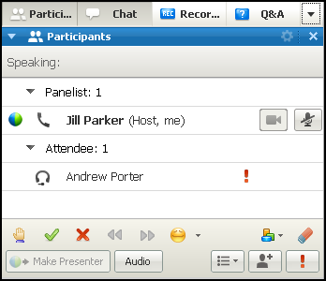
Interdependence and Commitment
To create interdependence and commitment you will need to foster an environment where every team member can flourish.
Interdependence and commitment are necessary when:
There is a high level of urgency associated with your project
Commitment is needed to get the job done
Creativity and innovation play an important role
The work requires a high degree of complexity
By show of hands how many of your teams are working under these conditions?
Notes:
Say:
As I mentioned earlier, you are not solely responsible for the success of the team. Every member is 100% accountable for the team’s success and the team can only be successful if there is interdependence and commitment. You are responsible however, for creating an environment where all team members understand how to optimally contribute to a high performing team.
Explain that interdependence and commitment are necessary when:
There is a high level of urgency associated with your project
Commitment is needed to get the job done
Creativity and innovation play an important role
The work requires a high degree of complexity
Ask the group the question on the slide.
Explain that they can acknowledge that these conditions exist on their teams by raising their virtual hand on the tool bar.

Slide 24
Facilitating Interdependence and Commitment
Three aspects of how a group interacts can facilitate interdependence and commitment:
Shared purpose means team members have a similar understanding of the team's objective and collective goals.
Social support means that team members contribute to each other's emotional and psychological well-being by offering encouragement and assistance.
Voice refers to the degree to which team members believe they have input into how the team carries out its activities.
Source: Boundless. “Shared Leadership.” Boundless Management Boundless, 26 May. 2016.
Notes:
Say:
If you raised your hand on the previous question then interdependence and commitment are necessary ingredients for your teams to be successful and high performing.
Taken together, these group dynamics can foster interdependence, commitment, a sense of trust and willingness to collaborate in support of the team.
Review the three aspect of group interaction on the slide.

Slide 25

Facilitating Interdependence and Commitment Continued
You will be divided into virtual breakout rooms and asked to:
Create strategies to ensure your teams have:
A shared purpose
Social support
A voice
Notes:
Note to facilitator: This activity will be carried out using breakout rooms. Work with the Virtual Producer to set these up in advance of the webcast. Discuss with the Virtual Producer the best way to conduct the large group debrief.
Ask participants to create strategies to ensure their teams have a shared purpose, social support and a voice.
Instruct the teams to record their responses on a whiteboard in their breakout room and be prepared to share their thoughts with the larger group when they return. Allow 10 minutes for this activity. No more than 4 breakout rooms. 3 is optimal.
Conduct a large group debrief of the breakout room discussions.

Slide 26
In Summary We Reviewed The…
Difference between a work group and a team
Inherent challenges when working with a team
Behaviors that have served you well in the past but could hinder your team and limit you as you lead a team
Skills that need to be acquired and others that need to be strengthened to be an effective Team Leader
Three aspects of how a group interacts that can facilitate interdependence and commitment: A shared purpose Social support A voice
Notes:
Thank the group for their thoughtful responses to the last activity.
Summarize the session by reviewing the slide.

Slide 27

Action Plan
What concepts from today’s webcast will you try, do more consistently, or stop doing?
How will you hold yourself accountable?
Notes:
Say:
Let’s use our final moments together to do some action planning.
Ask the questions on the slide.
Explain that they can comment by raising their virtual hand on the tool bar.
Call on each person who raised his or her hand and un-mute the audio if necessary.

Slide 28

Teaming Offerings
Self-Serve High Performance Teaming @ Merck Community
Team Performance On-line Surveys
Teaming Grab & Go Materials
Virtual Teaming Workshops for Team Members and Leaders
Insights Discovery Workshops
Leading a Virtual Team Workshop Topics:
Influencing Remotely
High Impact Comm Skills
Building Trust Virtually
Conducting Effective Virtual Meetings
Managing Accountability & Coaching in a Virtual Environment
Team Leader Webcasts Topics:
Orientation: Getting Your Team off to a Good Start
Orientation: Building Trust
Moving from an Individual Contributor to a Team Leader
Becoming a Top Team Leader
(Instructor Led Program)
Team Leader Webcasts
Customized Teaming Solutions
Notes:
Explain the teaming offerings.
Review the slide.

Slide 29


Additional Learning Resources
Your “one stop” for leadership resources to help you with Driving the Business, Leading Your People, and Developing Yourself. Updated articles, e-learning modules, videos, books/summaries, and other resources to help you develop your leadership skills in critical areas such as Business Acumen, Coaching, Performance Management, and Diversity & Inclusion. Join the Community: http://ldc.merck.com
High Performance Teaming Community
Resources for Teams: Members and Leaders of Intact Teams, Virtual Teams, and Ad Hoc Teams.
Resources are available in several languages.
Join the Community: http://ts1.merck.com/com/teaming/
Easy access via “Quick Links” on the LDC home page (ldc.merck.com)
Notes:
Point out that additional learning resources that are available for Team Leaders including the:
Leadership Development Center
High Performance Teaming site

Slide 30






Additional Learning Resources Easy access via “Quick Links” on the Leadership Development Center home page (ldc.merck.com)
Harvard Manage Mentor | Books 24x7 | The Merck Library
Business-related e-learning, videos, articles, and toolkits Go to https://merck.myhbp.org/hmm12 | On-demand access to complete texts of books, book summaries, audiobooks, research reports and best practices Log in, set up your membership, and start reading at www.books24x7.com | Access 13+ research databases of full-text articles in academic, scientific, industry, and trade journals Go to library.merck.com to search resources
Leading Edge | Corporate Executive Board | Cultural Navigator
On demand access point to world-class thinking on leadership and management for all professional levels. | Articles, research, best practices, bench-marking, training, and personalized assistance Go to www.executiveboard.com to sign up with your work email address | Access self-assessment, country or regional cultural information, and generational diversity information Go to passport.culturalnavigator.com
Notes:
Explain that there is easy access to additional resources via “Quick Links” on the Leadership Development Center home page (ldc.merck.com) including:
Harvard ManageMentor which includes business-related tools
Books including audio books
The Library that includes academic and scientific journals
Leading Edge which focuses on world-class thinking on leadership
Corporate Executive Board offers advisory services and technology solutions for growing your business
Cultural Navigator offers access to country and regional cultural information

Slide 31


Notes:
Thank the participants for attending and for their attention and participation.

